Slide 1
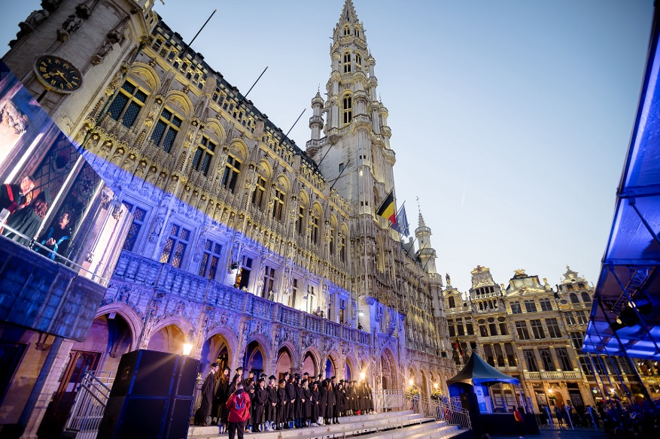
Welcome to SciencePo ULB! Prof. Emilie van Haute

Slide 2
This presentation can be found on the web pages of the PhiSoc Faculty (PhiSoc – SciencePo)

Slide 3
Classes start on 16 September

Slide 4
Université libre de Bruxelles
Faculté
de Philosophie et Sciences sociales
4 departments

Slide 5
2,000 students
Brussels, capital of Europe, 2nd most international city
International environment
First in the field of political science in French-speaking Belgium, top 100 in the world

Slide 6
Studies are organized in 3 levels
Bachelor: 1st cycle
Master: 2nd cycle
PhD: 3rd cycle

Slide 7
Academic calendar
Three semesters, each followed by an exam period:
Q1 and Q2: 2 teaching semesters (12 weeks)
Q3 (summer): internships, preps, retake

Slide 8
Your studies at SciencePo ULB
Evaluation
Courses are evaluated at the end of the semester
1st session in January for courses of Q1, and June for courses of Q2
Retake session in August/September
Pass if 10/20 or more
Grades: 12/20 = satisfaction; 14/20 = Distinction; 16/20 = Grande Distinction; 18/20 = LPGD

Slide 9
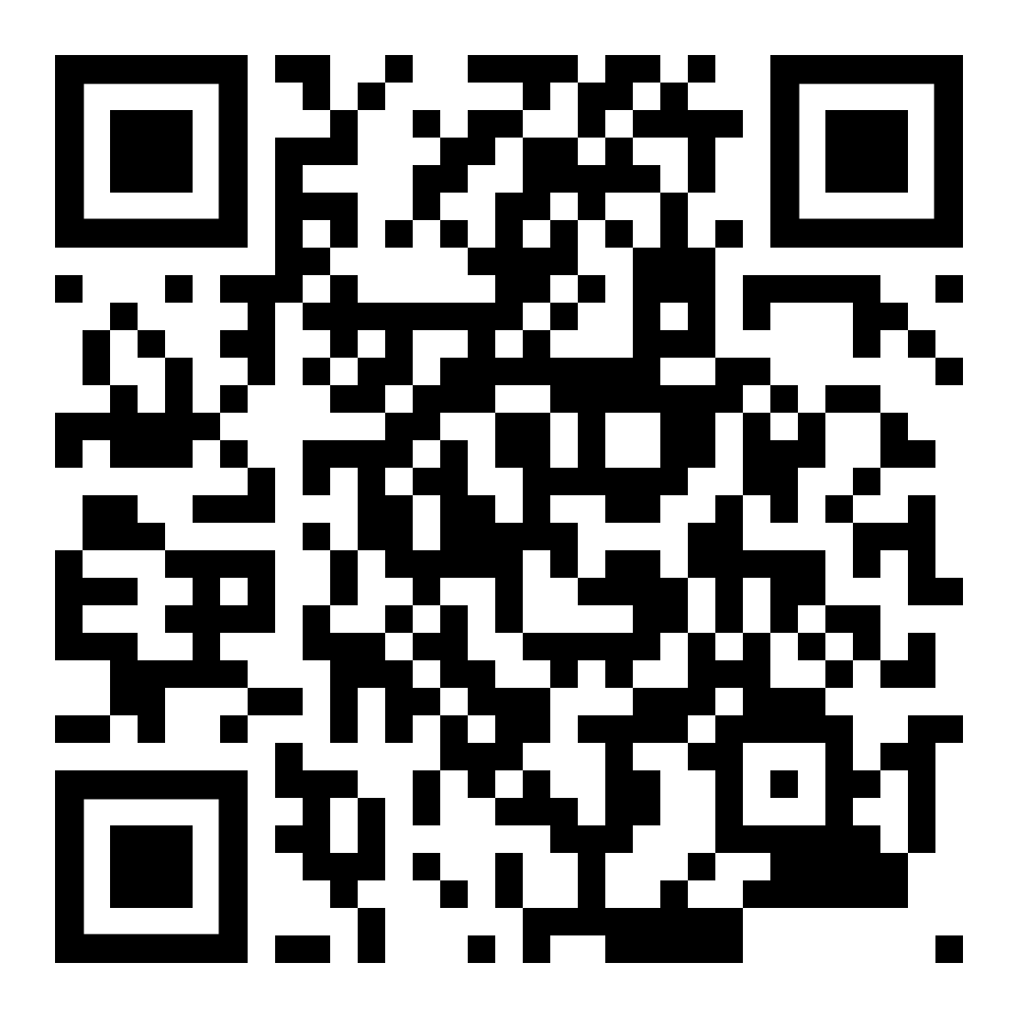
Your studies at SciencePo ULB
Conditions to pass:

Slide 10
Programme Annuel Etudiant (PAE)
Each student gets their PAE – individual annual program
The PAE is finalized during the month of September/October.
In the meanwhile, you have to check your schedule by program or by course

Slide 11
Student Fees
you have to pay your student fees
50 € BEFORE 31/10/2024
And the remaining part before 01/02/25
otherwise your year will be lost!

Slide 12
Contacts
Academic staff – PROFESSORS
Scientific staff – TEACHING ASSISTANTS
Administrative staff - PATGS

Slide 13
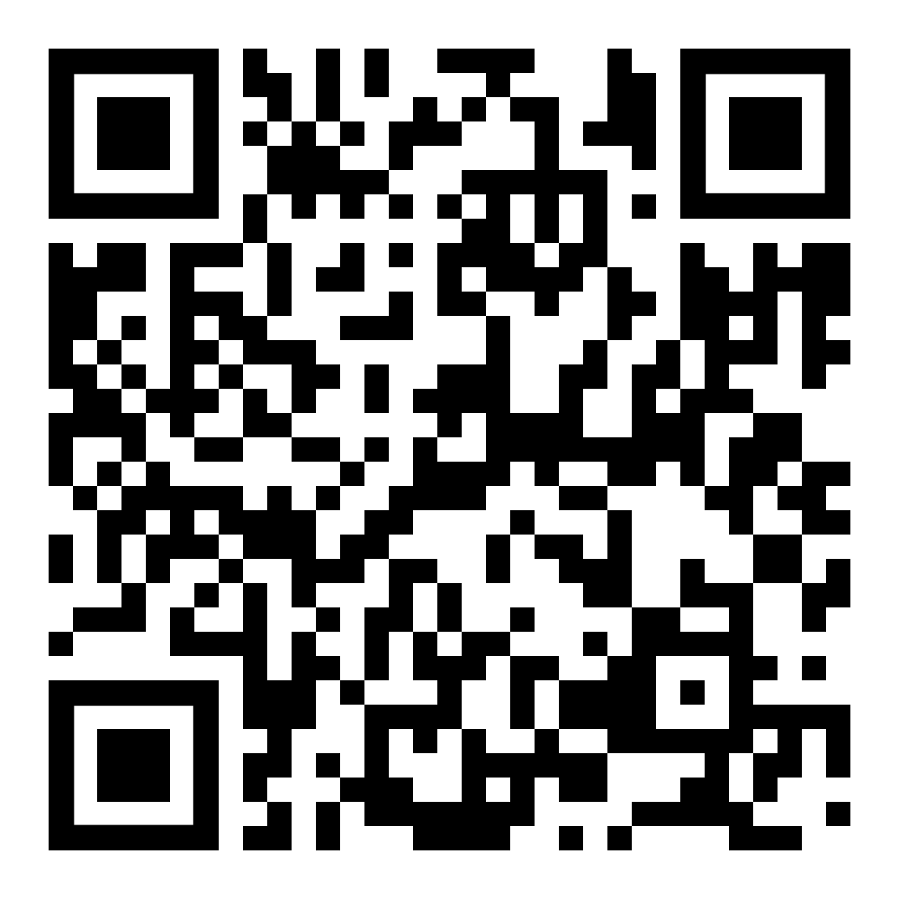
Contacts
Secretary: Yousra Chahboun
For administrative issues (ex.: registration, retake session, etc.)
Email : yousra.chahboun@ulb.be
Bureau: H3.127
Academic coordinator: Emilie van Haute
Office S11.125
Office hours: Mondays, 9.30-11.30
Jury and delibrations: Corinne Torrekens

Slide 14
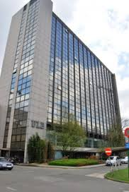
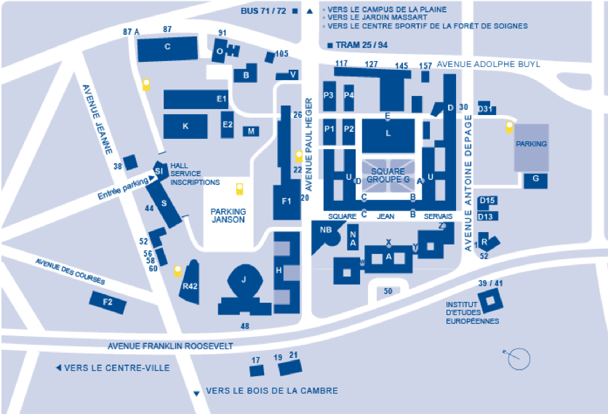
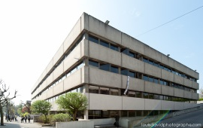
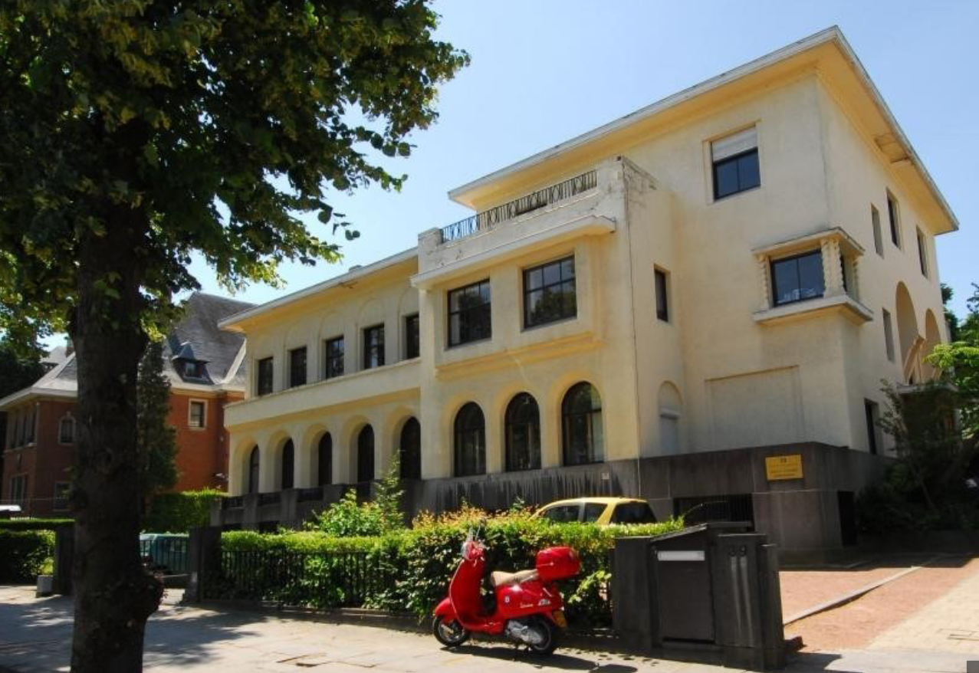
3 buildings for SciencePo
S building - Bâtiment H - Institut d’études européennes (IEE)

Slide 15
How to find a classroom?
S.AY2.112
Campus
S = SOLBOSCH
Building
Door
Level
Room number

Slide 16
Main TOOLS

Slide 17
MonULB
Online portal with notifications and official communication
To be checked daily!
monulb.be
Also link to all other tools/platforms

Slide 18
Course and exam schedule
Online portal
HORAIRES ULB (Time Edit)
ulb.be/fr/horaires

Slide 19
Virtual University
« UV »
Online portal with all course material for each course
uv.ulb.ac.be/login/index.php

Slide 20
IMPORTANT!
You can access the course schedule and the UV even if your student ID is not yet activated, until the end of September

Slide 21
ULB email
Only official channel of communication
To be checked daily
Application OUTLOOK available for smartphone.

Slide 22
A few services available at ULB
Student social service- sse@ulb.be
EBS / ESH - ebs.esh@ulb.be
Aimer à l’ULB - aimeralulb.be
PSY Campus - psycampus@ssmulb.be
ULB SANTE - ulb.be/sante

Slide 23
Your course program at SciencePo ULB
Structure (60 credits)
30 credits linked to FD (seminar + FD)
10 credits compulsory courses
20 credits of optional courses (IR OR Politics & government)
Catalogue: https://www.ulb.be/fr/programme/poli4-j#programme
Check the schedules and the UV

Slide 24
Program

Slide 25
Program

Slide 26
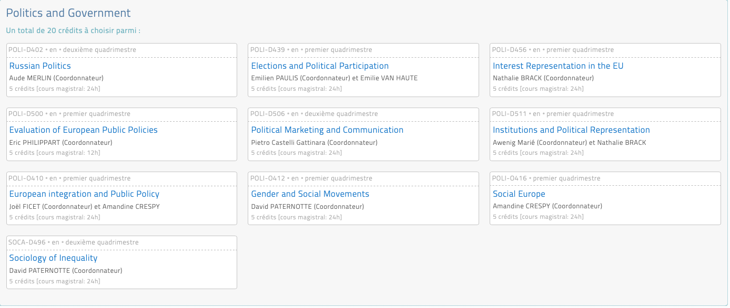
Program

Slide 27
International Welcome Desk

Slide 28
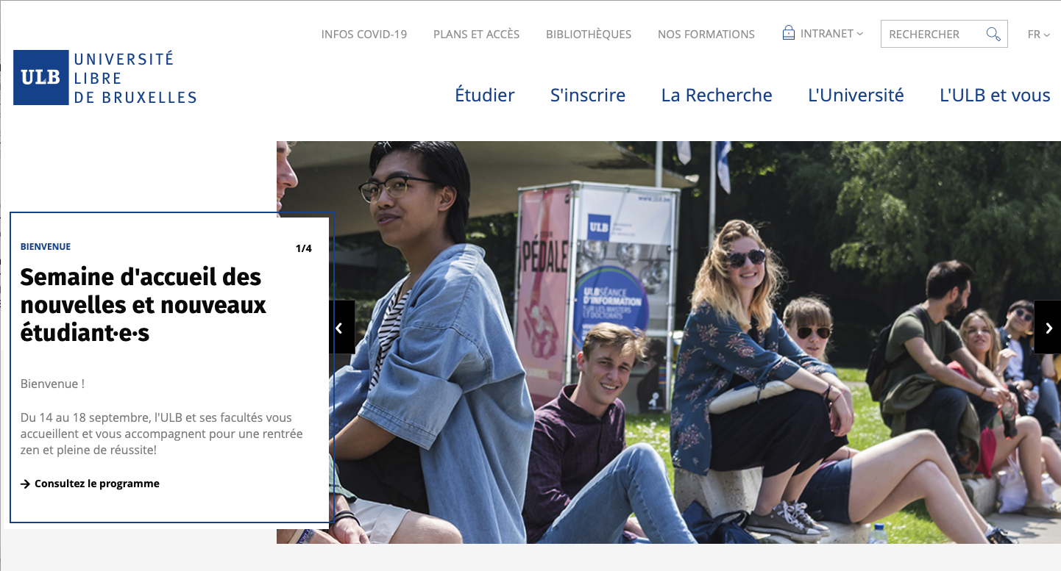
How to contact a professor?
Create a ULB email
Essential to get ULB official information
Essential for professor to identify you
Check the contact list

Slide 29
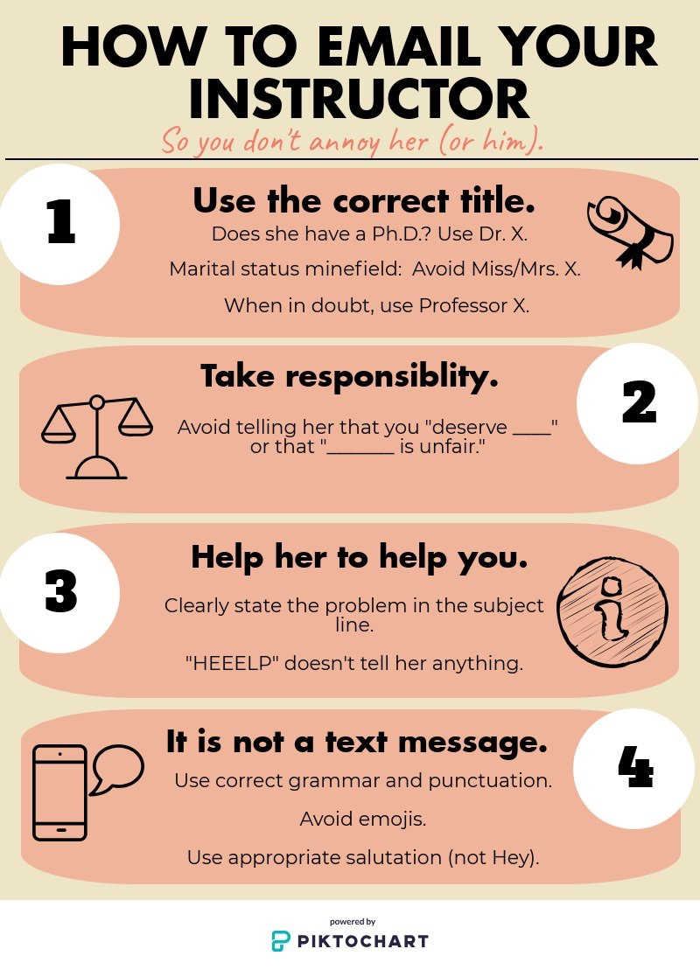
Mention the course
Check that the answer to your question is not in the course outline
Evaluate the urgency (can it wait until next class/office hours?)

Slide 30
Language support
4 possibilities:
F9 : www.f9languages.eu + Facebook
Conversation tables : https://langues.ulb.be
Language duos: http://tandems.ulb.ac.be
MOOC ULB ‘Spice up your English’: http://podcast.ulb.ac.be/site/moocs-SpiceUp.html

Slide 31
BEPSS
Bureau étudiant de la Faculté de Philosophie et Sciences sociales
Chloé PIERLET, President
Keo SENNEKAMP, vice-President Office H1.145
bepss.ulb@gmail.com
Instagram : bepss.ulb
Facebook : https://www.facebook.com/bepss.ulb

Slide 32
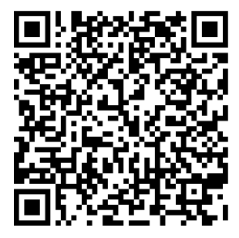
Registration for buddy system

Slide 33
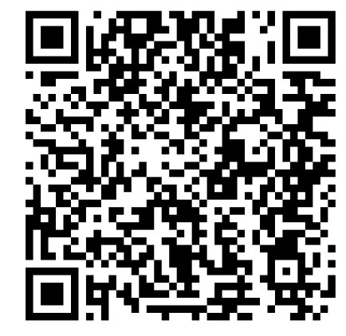

Slide 34
CPS
Cercle des étudiants en Philosophie et Sciences sociales
Laura CAZIER, President
Stéphanie KRÖGER, vice-President
Instagram : insta_cps
Facebook : Cercle des Etudiants en Philosophie et Sciences Sociales - CPS
Email : cpsulb@gmail.com

Slide 36
Elections of student representatives
in December 2024 via the app Belenios
Your participation is important !
election.phisoc@ulb.be
+ infos / email MON ULB

Slide 37
Who are your student representatives this year?

Slide 38
Cellule EBS/ESH Étudiants à besoins spécifiques ou en situation de handicap
You think that your medical situation may have an impact on your studies?
Based on an asessment, the Cellule EBS/ESH determines with you reasonable adaptations to lift the barriers to your studies.
⚠ Deadline for the procedure:
⚠ Q1 = 15 October
⚠ Q2 = 1 March
More information: ebs.esh@ulb.be

Slide 39
How to get the EBS/ESH status?
3 steps:
Fill in a form on MonULB
Provide the required medical documents
Participate in an interview with the Cellule EBS/ESH
More info via the QR code or ebs.esh@ulb.be

Slide 41
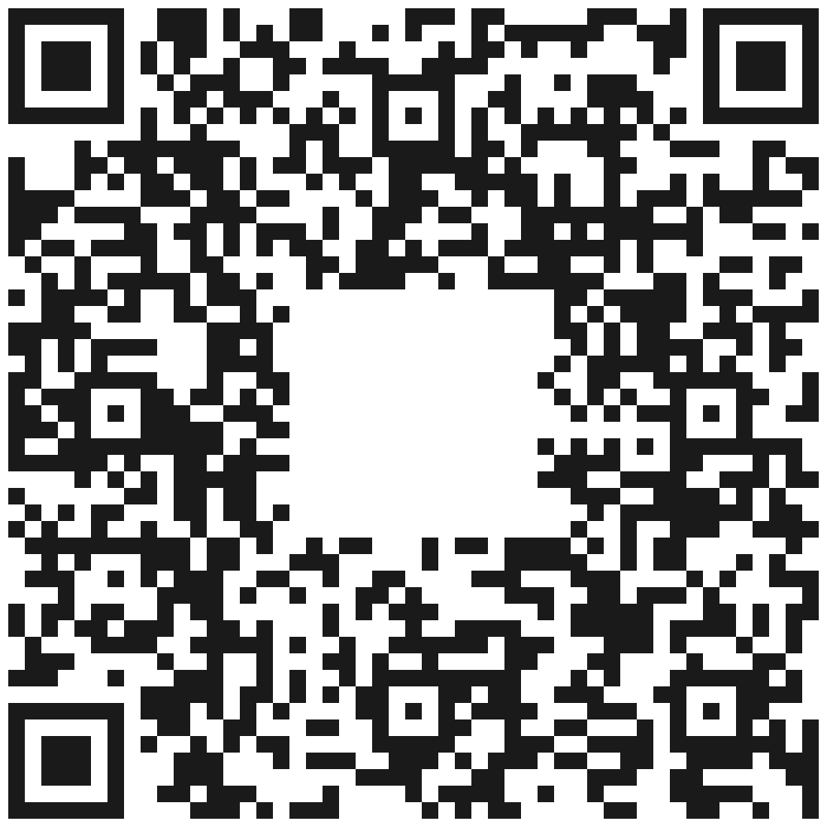
Join SciencePo ULB on social media
@SciencePoULB

Slide 43
SciencePo ULB wishes you an excellent academic year!

